Slide 1
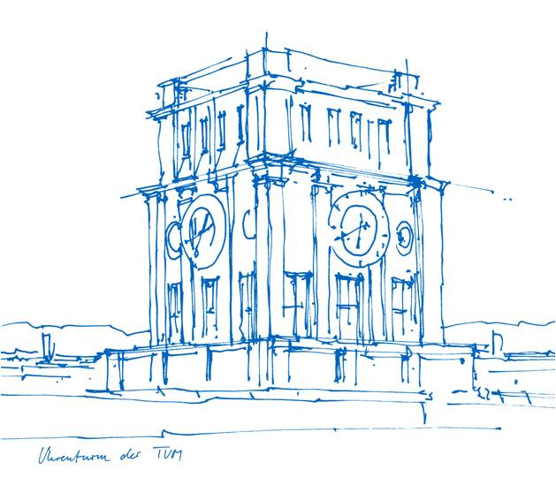
Master Thesis Initial Report - Research on Modulation and Control Optimization for MMC-SST
Presenter: Haoheng Li
Supervisor: Dr. Gean Maia de Sousa
Professor: Prof. Dr.sc. ETH Zürich Marcelo Lobo Heldwein
Technical University of Munich
12, December, 2025

Slide 2
Outline
Introduction
Problem Statement and Research Gap
Objective & Methodology
Notes:
Let's begin with the outline. I'll start with an introduction, followed by detailed explanations of Observer-Based Methods and Switching-State-Based Methods, including a simulation study. Finally, I'll provide a comparison of these methods, discuss future research directions, and conclude with a summary.

Slide 3
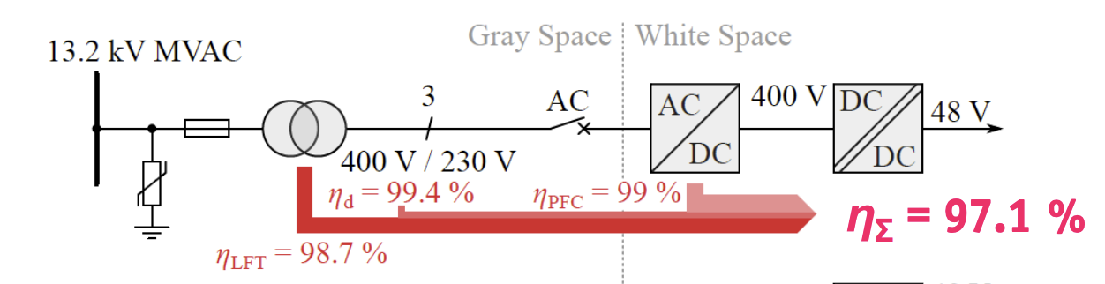
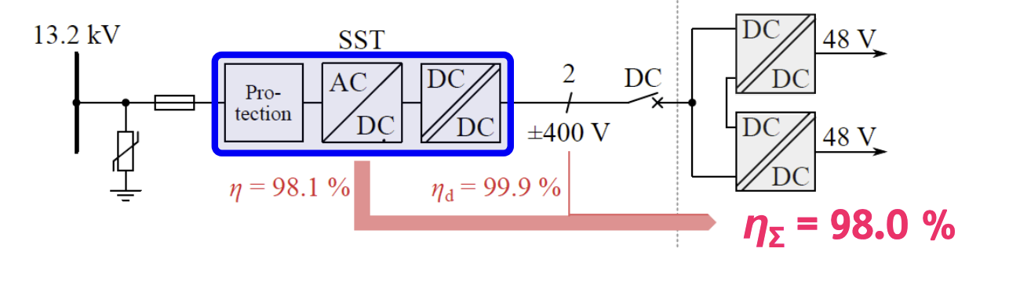
What is SST and its application
State-of-art middle voltage interface for AC-DC
A Solid State Transformer (SST) is a power electronic converter with Middle-Frequency Transformer (MFT).
Key Advantages:
Volume/Weight reduction (due to high frequency).
Full power flow control (Active/Reactive).
Higher efficiency for AC-DC application
Solid state transformer middle voltage interface

Slide 4
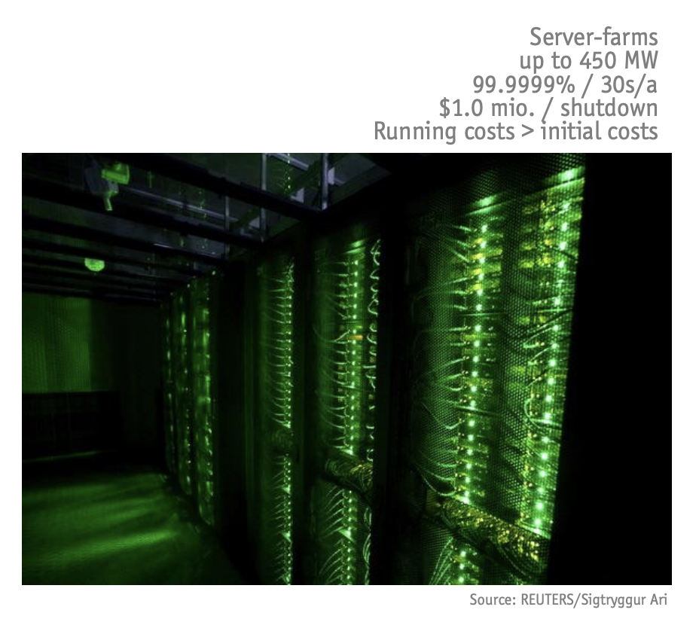
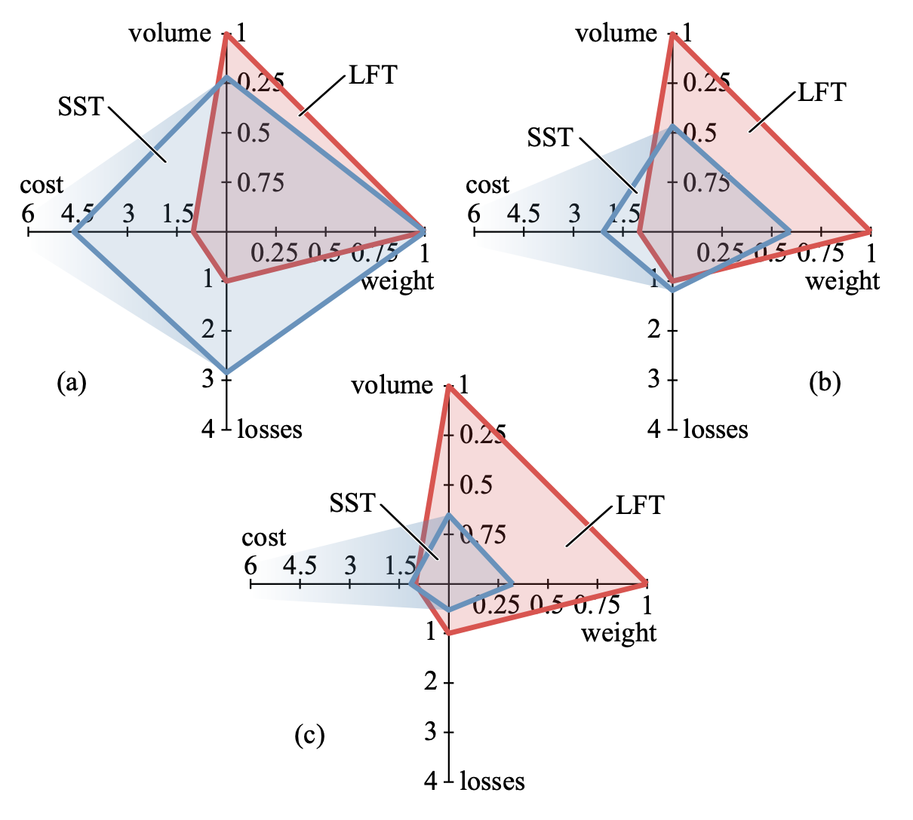
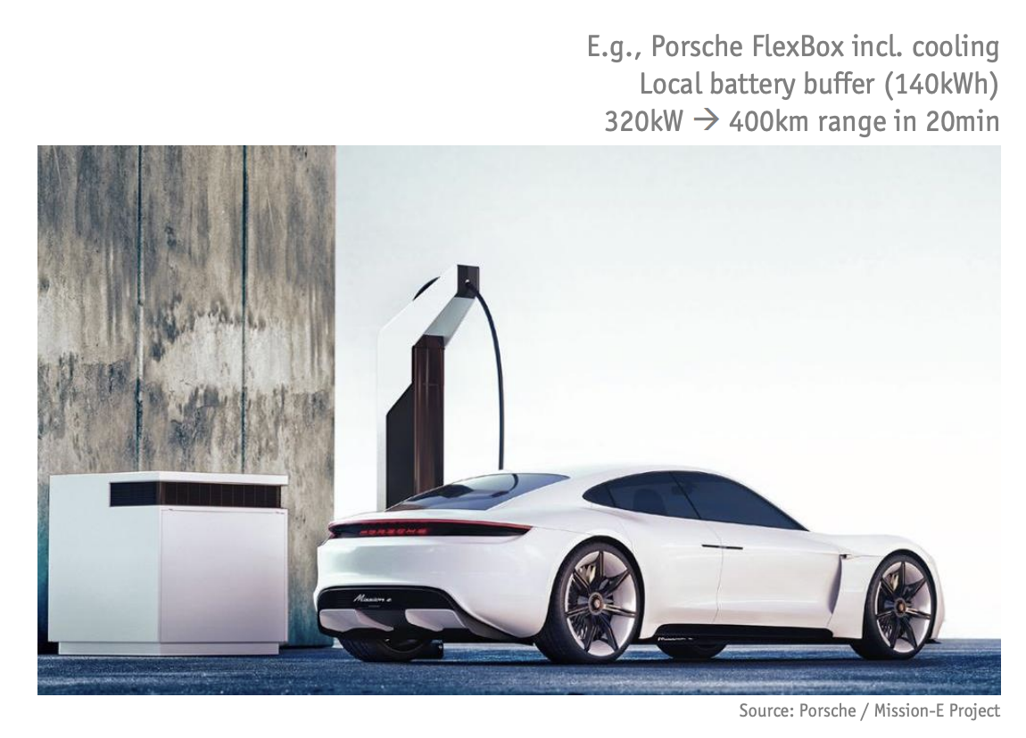
What is SST and its application
Data Center
Comparison of SST and Low Frequency Transformer(LFT) Solution
AC-AC
50% AC-AC and 50% AC-DC
AC-DC
Super Charge station

Slide 5
Outline
Introduction
Problem Statement and Research Gap
Objective & Methodology
Notes:
Let's begin with the outline. I'll start with an introduction, followed by detailed explanations of Observer-Based Methods and Switching-State-Based Methods, including a simulation study. Finally, I'll provide a comparison of these methods, discuss future research directions, and conclude with a summary.

Slide 6
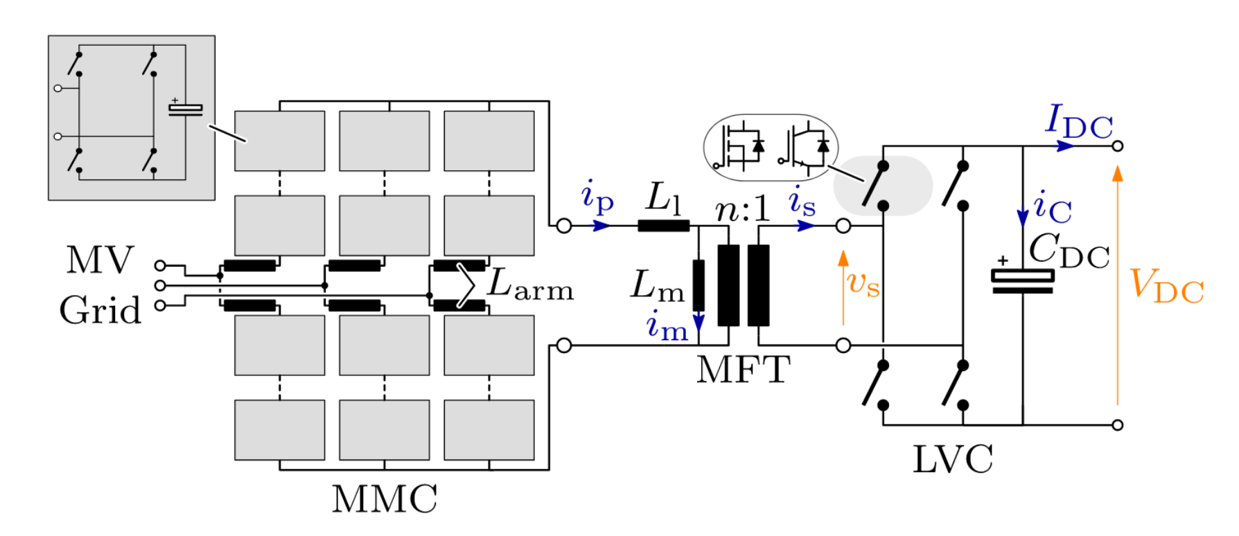
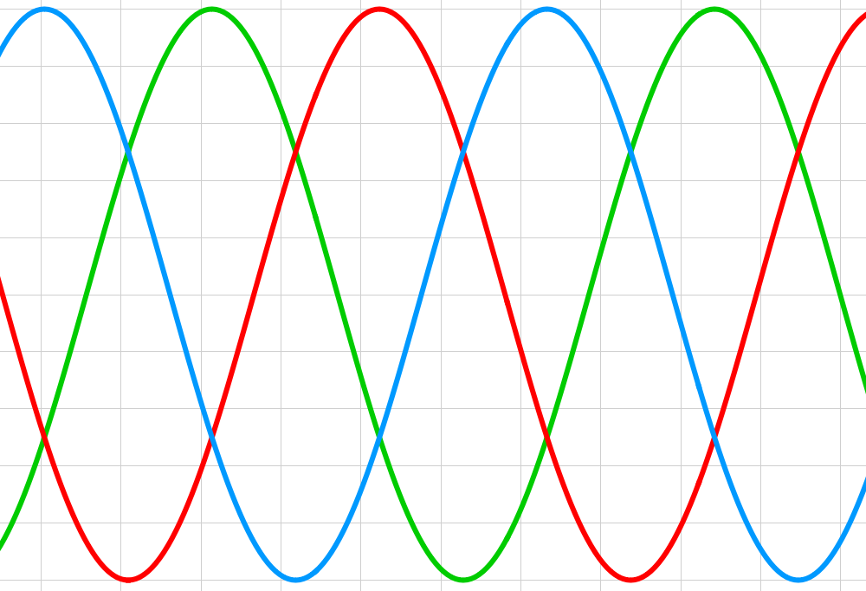


Topology Analysis
-Mudular Multilevel Converter (MMC)-SST
10kV 50Hz Middle Voltage AC
Middle Frequency square wave
800V DC Voltage

Slide 7
Existed Modulation Method
MMC AC-AC Stage
DC/DC Stage Challenge
Nearest Level Modulation
✅ Very Low Losses
❌ Poor Waveform Quality (High THD)
Pulse Width Modulation
✅ Good Harmonic performance
❌ Huge Switching Losses
Phase Shift modulation
❌ Limited Phase Shift control for the MFT to ensure Zero Voltage Switching (ZVS).

Slide 8
Outline
Introduction
Problem Statement and Research Gap
Objective & Methodology
Notes:
Let's begin with the outline. I'll start with an introduction, followed by detailed explanations of Observer-Based Methods and Switching-State-Based Methods, including a simulation study. Finally, I'll provide a comparison of these methods, discuss future research directions, and conclude with a summary.

Slide 9
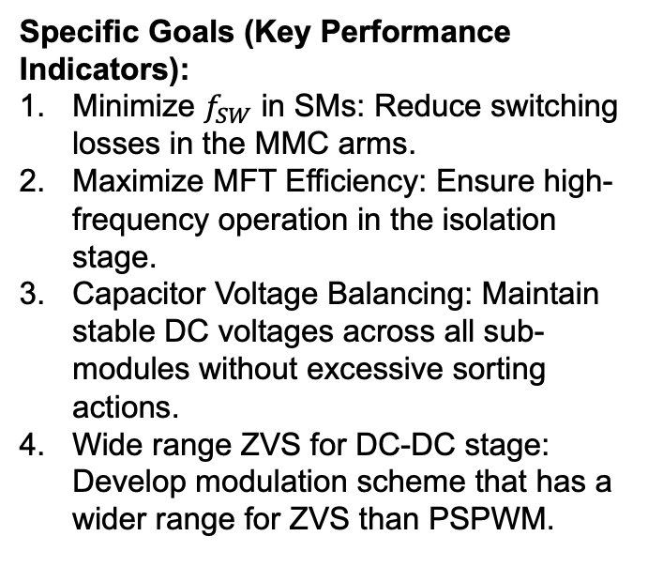
Objectives
Core objective: Develop a Optimized Modulation and Control Scheme for MMC-SST
Specific Goals (Key Performance Indicators):
Minimize $f_{SW}$ in SMs: Reduce switching losses in the MMC arms.
Maximize MFT Efficiency: Ensure high-frequency operation in the isolation stage.
Capacitor Voltage Balancing: Maintain stable DC voltages across all sub-modules without excessive sorting actions.
Wide range ZVS for DC-DC stage: Develop modulation scheme that has a wider range for ZVS than PSPWM.

Slide 10
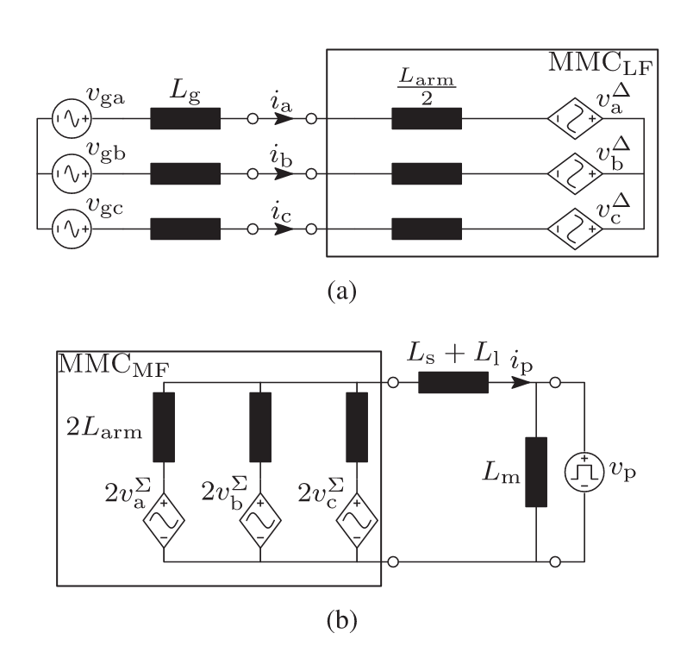
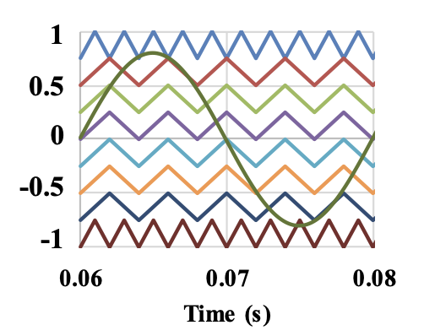
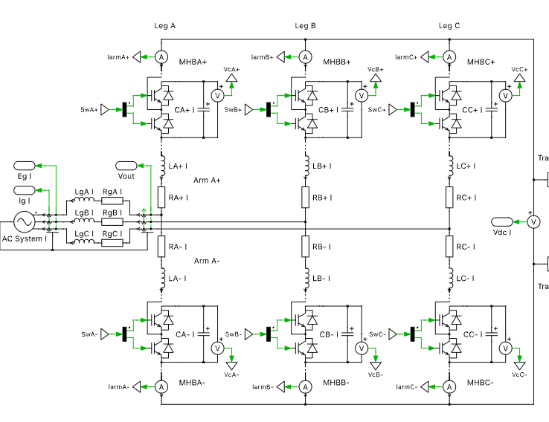
Methodology
Mathematical modeling
AC-AC MMC
DAB
Analysis of existed modulation and control methods for MMC-SST
Research on modulation and control optimization
Hybrid modulation scheme for MMC AC-AC stage
Pulse amplitude control (PAC) for the DAB DC-DC stage for wide range ZVC
C code to implementing voltage balancing for submodules.
Simulation verification using PLECS
Verifying the method using PLECS
Compared the proposed method with the existing

Slide 11
Expected Outcome
Theoretical Model: Mathematical derivation of the modulation strategy.
Simulation Model: A complete, running MMC-SST model in PLECS.
Performance Comparison (The Evidence):
  Efficiency
  THD Analysis
  Switching Count Reduction
Contribution: A novel balancing algorithm that decouples sampling frequency from switching frequency.

Slide 12
Timeline
2025
2026
Activity
Nov
Dec
Jan
Feb
Mar
Apr
May
Status
Research
Literature research
modulation
PAC DAB
Proposing method
Modeling
MMC DC-AC
DAB PS
MMC AC-AC
DAB PAC
Simulation
MMC DC-AC
MMC AC-AC
MMC-SST
Proposed method
Comparision
Thesis writing
Introduction
Existing research
Math model
Proposed method
Simulation result
Thesis submission
Initial report
Midterm report
Final report

Slide 13
Thank You & Questions
Presenter: Haoheng Li
Supervisor: Dr. Gean Maia de Sousa
Technical University of Munich
12, Dec, 2025
Notes:
That concludes my presentation. Thank you very much for your attention. I’d be happy to take any questions.加

